Slide 1
ALARM USING REAL TIME CLOCK
G PULLA REDDY ENGINEERING COLLEGE(AUTONOMOUS) MINOR DEGREE PROJECT
TEAM MEMBERS: GUIDE:
K. APARNA (179X1A05B5) Sri. T. THAMMI REDDY,
P. PAVANI REDDY (179X1A05C7) Associate Professor,
R. SRAVYA THARUNI (179X1A05D1) Department of ECE

Slide 2
CONTENTS
1 ABSTRACT
2 INTRODUCTION
5 BLOCK DIAGRAM
8 HARDWARE COMPONENTS REQUIRED
10 PROGRM DESCRIPTION
12 APPLICATIONS
13 CONCLUSION
6 CIRCUIT DIAGRAM
9 DESCRIPTION OF COMPONENTS
7 WORKING OF CIRCUIT
14 REFERENCES
3 LITERATURE SURVEY
4 LIMITATIONS
11 EXPECTED RESULT

Slide 3
ABSTRACT
In this project, we designed an Arduino based Real Time Clock with alarm. A Real Time Clock or RTC is a battery powered clock that measures time even when there is no external power or the microcontroller is reprogrammed. An RTC displays clock and calendar with all time functions. One of the frequently used RTC IC/s DS3231 is used in this project along with Arduino. The main Aim of this project is to create a real time clock along with alarm feature. We used three major components which are IC RTC DS3231, Arduino Uno Board, and 16x2 LCD modules. Here Arduino is used for reading time from DS3231 and display it on 16x2 LCD. DS3231 sends time/date to Arduino. A buzzer is also used for alarm indication, which beeps when alarm is activated. Here, the code is designed in a way such that when the set alarm time is equals to clock time then the buzzer is switched on for predetermined time. So, the buzzer will be activated and the bell will be ringing for 1 minute from the instant it is activated and simultaneously LCD screen will display the time and date. There is a provision to change the alarm time so that it can be reused again and again.

Slide 4
INTRODUCTION
This project is aimed to create a real time clock with alarming feature.
It is a Automatic Electronic Circuit consisting of several components like Buzzer, LCD, Switches etc. All these components are controlled by a Microcontroller which has been programmed before.
The main controller Unit of the System is RTC (Real Time Clock) module. RTC modules are simply TIME and DATE remembering systems which have battery setup which in the absence of external power keeps the module running.
Several push buttons are used to set time for the alarm. Various tasks of push buttons are to set the hour, minute and to reset

Slide 5
LITERATURE SURVEY
Existing System
Most of the digital clocks are of very high price and low quality. Many of those cannot provide the time accurately for longer period as those are designed with timer IC’s like 555 timer. Again some digital clocks loss their data whenever the power supply shuts down.
Proposed System
The proposed system consists of the RTC module which has its internal battery running even though there is no power supply there by providing the exact time accurately.

Slide 6
LIMITATIONS
This system cannot store the history of all past alarms.
Use of Push buttons in this system is not so easily understandable.

Slide 7
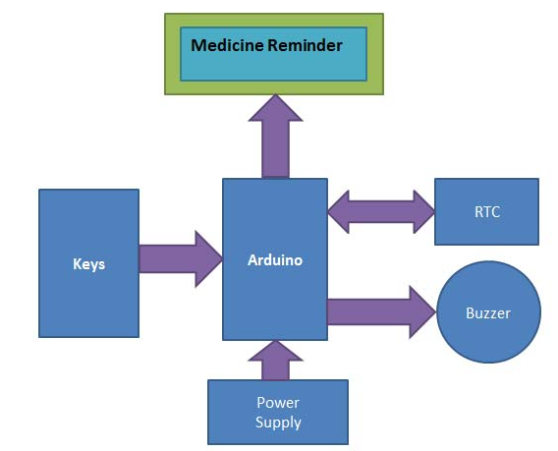
BLOCK DIAGRAM
(LCD)
(Switches)

Slide 8
DESCRIPTION OF BLOCK DIAGRAM
The power supply to the system is provided by the lithium battery
All the components i.e. RTC module, LCD, Buzzer, Push buttons, Battery are connected to the Arduino board.
LCD is used to display the date, time and temperature which is intern connected to the I2C adapter. Buzzer is used for producing the alarm sound.

Slide 9
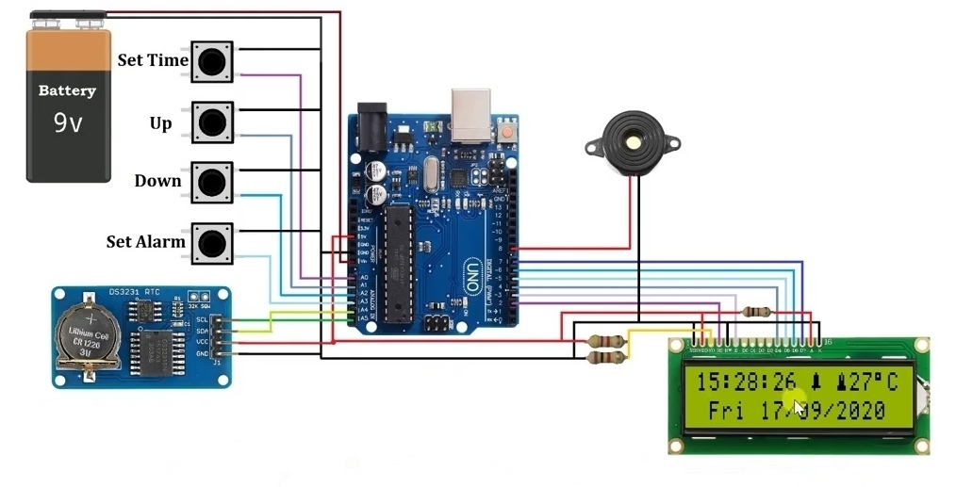
CIRCUIT DIAGRAM
Arduino UNO
Buzzer
RTC Module
LCD display

Slide 10
WORKING OF MODULE
Upload the code after the connections then LCD displays the current date and time.
Four buttons namely Set Time, Up, Down, Set Alarm are used for setting alarm.
When we press the Set Time we can the set time using Up and Down push buttons for hour and if we press again Set Time button it is used to move next digit like to minute and so on.
When we press the Set Alarm button we can seen alarm activated or not.
To change the alarm we press Up button and Down button. To set the alarm press the set alarm button.
When both set time and alarm time are equal then buzzer sounds on for one minute.

Slide 11
COMPONENTS REQUIRED
Arduino Uno
DS3231 RTC(Real Time Clock) Module
16x2 LCD(Liquid Crystal Display)
I2C Adapter
4 Push Buttons
Buzzer
Resistors – 4.7KΩ,1KΩ,100Ω
Jumper Wires
Battery
Breadboard

Slide 12
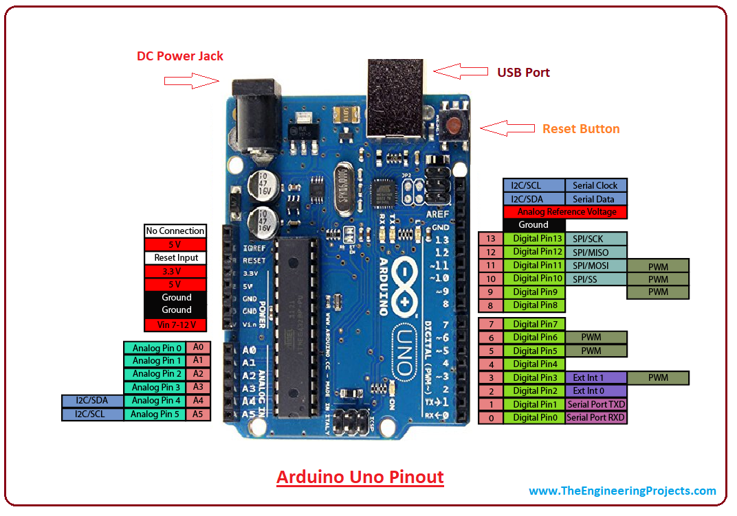
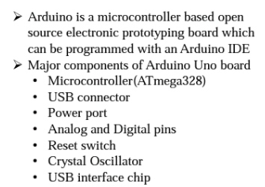
ARDUINO UNO

Slide 13
LCD(Liquid Crystal Display)
A 16x2 LCD can display 16 characters per line and there are 2 such lines.
Each character is displayed in 5x7 pixel matrix.
The utilization of current is 1mA with no backlight
These are obtainable in Blue & Green Backlight
The operating voltage of this LCD is 4.7V-5.3V
16×2 LCD has two registers like data register and command register
IC/ I2C Interface Adapter Module is used for 16x2 LCD display

Slide 14
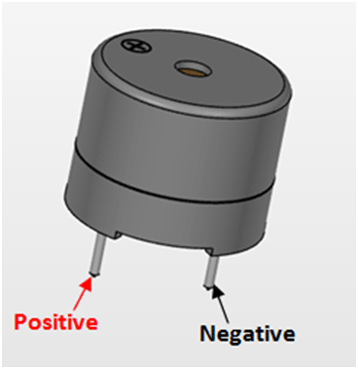
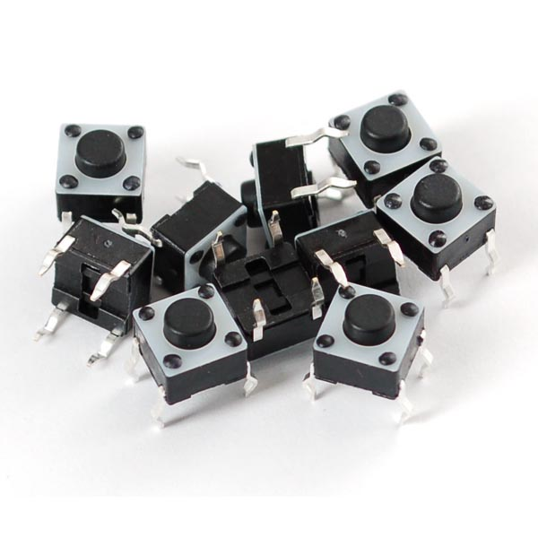
BUZZER
A buzzer or beeper is an audio signaling device
Operating Voltage: 4-8V DC
Sound Type: Continuous Beep
Breadboard and Perf board friendly
PUSH BUTTONS
Push button switch is a small sealed mechanism that completes an electric circuit when you press on it.
These buttons are typically made of plastic or metals.

Slide 15
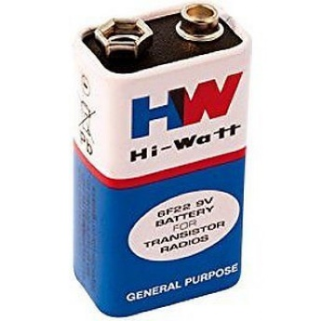
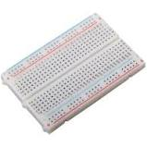
BATTERY
A battery is a device consisting of one or more electrochemical cells with external connections for powering the electrical devices. In this project we have used 9V battery.
A breadboard is used to build and test circuits quickly before finalizing any circuit design. The breadboard has many holes into which circuit components like Ics and resistors can be inserted.
BREAD BOARD

Slide 16
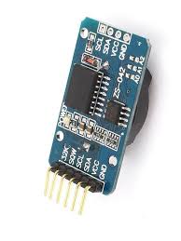
RTC(Real Time Clock)
RTC counts seconds, minutes, hours and year
Operating voltage of DS3231 module: 2.3V – 5.5V
Can operate on LOW voltages
Consumes 500nA on battery backup
Maximum voltage at SDA , SCL : VCC + 0.3V
Operating temperature: -45ºC to +80ºC
The purpose of an RTC or a Real Time Clock is to provide precise time and date which can be used for various applications. RTC is an electronic device in the form of an Integrated Chip (IC) available in various packaging options. It is powered by an internal lithium battery. As a result of which even if the power of the system is turned off, the RTC clock keeps running.

Slide 17
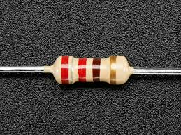
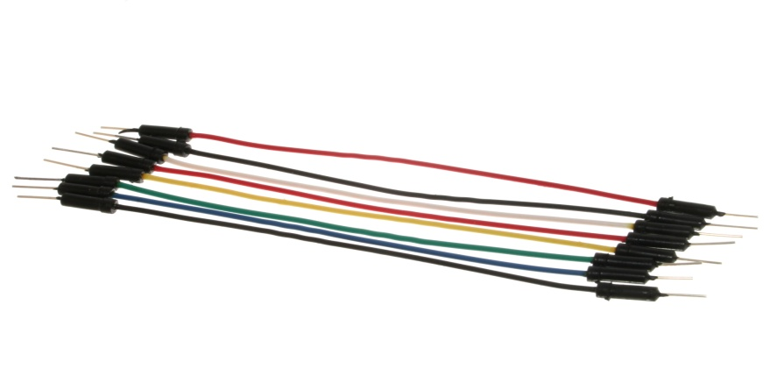
RESISTANCE
Electricity flows through a material carried by electrons, tiny charged particles inside atoms. It is a electrical component that is used to control the flow of current to other components. Measured in units of ohms (symbol: Ω).
JUMPER WIRES
Jumper wires are used for making connections between items on your breadboard and your Arduino’s header pins. Use them to wire up all your circuits

Slide 18
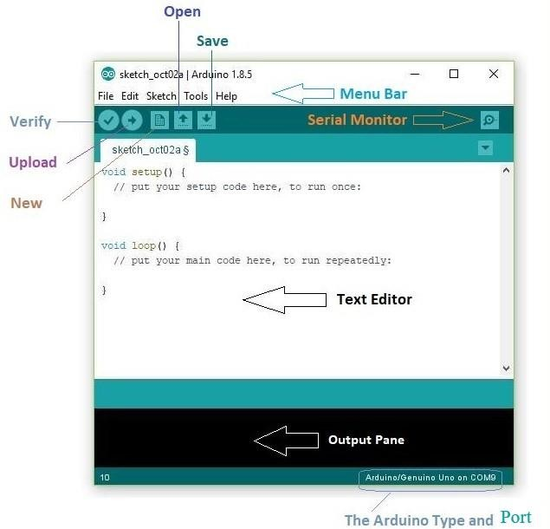
ARDUINO IDE
An Arduino software is an open-source hardware and software company, that designs and manufacture the microcontroller kits for building digital devices.
Programs written using Arduino Software (IDE) are called sketches. These sketches are written in the text editor and are saved with the file extension *. ino.

Slide 19
PROGRAM DESCRIPTION
To program for this real time clock, we have used some libraries for extracting time/date from DS3231 and for displaying on LCD, which are given below
#include<wire.h>
#include<EEPROM.h>
#include<DS3231.h>
#include<LiquidCrystal.h>
And initialization of RTC,LCD and input output are performed in set up loop
Rest of things like reading time, setting alarm is performed in void loop section
#include <DS3231.h>
#include <Wire.h>
#include <LiquidCrystal.h>

Slide 20
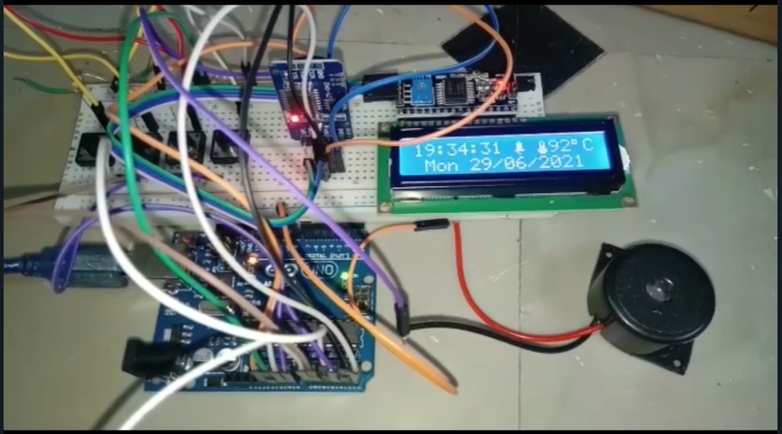
RESULT

Slide 21

RESULT

Slide 22
ADVANTAGES
The RTC module is economical
This model works without any support of external battery
This allows us to set the time as per our requirements

Slide 23
APPLICATIONS
Schools and Colleges
Washing Machines
Microwave Ovens
Video Recorders
Security Systems
Digital Watches

Slide 24
CONCLUSION
Now-a-days different pattern of digital clocks are available in market. Most of them are of very high price and low quality. Many of those cannot provide the time accurately for longer period as those are designed with timer IC’s like 555 timer. Again some digital clocks loss their data whenever the power supply shuts down. But our designed multipurpose digital clock is accurate because of its Real Time Clock module that keeps track of the system time and update.

Slide 25
REFERENCES
https://create.arduino.cc/projecthub/embeddedlab786/real-time-clock-with-alarm-40a1d0
Arduino Uno Pin Diagram, Specifications, Pin Configuration & Programming (components101.com)
DS3231 RTC Module Pinout, Configuration, Example Circuit & Datasheet (components101.com)
16x2 LCD Module: Pinout, Diagrams, Description & Datasheet (components101.com)

Slide 26


